Slide 1
CSIT988/CSIT488 Security, Ethics and Professionalism Week 8: Security Management Models & Practices
Subject Coordinator: Guangyou Zhou
Central China Normal University
2024

Slide 2
Week | Lecture Topics | Readings
1 | Introduction and overview of the subject | Chapter 1 / No Tutorials
2 | Information security management | Chapter 1
3 | Planning for security | Chapter 2
4 | Planning for contingencies | Chapter 3
5 | Information security policy | Chapter 4
7 | Developing the security program | Chapter 5
8 | Security management models & practices | Chapter 6, 7
9 | Risk management: identifying and accessing risk | Chapter 8
10 | Risk management: controlling risk | Chapter 9
11 | Protection mechanisms | Chapter 10
12 | Personnel and security | Chapter 11
13 | Law and Ethics Exam Review | Chapter 12

Slide 3
Introduction
Information security models
are standards that are used for reference or comparison
serve as the stepping-off point for emulation and adoption

Slide 4
Blueprints, Frameworks, and Security Models
To create or maintain a secure environment
Design a working security plan
Implement a management model to execute and maintain the plan
Begin by creating or validating a security framework followed by the development of an information security blueprint.
Blueprint: describes existing controls and identifies other necessary security controls.

Slide 5
Blueprints, Frameworks, and Security Models (cont’d.)
Framework
The outline of the more thorough blueprint
Which is the basis for the design, selection, and implementation of all subsequent security controls
Most organizations draw from established security models and practices to develop a blueprint or methodology
A security model is a generic blueprint offered by a service organization.

Slide 6
Access Control Models
Access controls
Regulate the admission of users into trusted areas of the organization
Both the logical access to the information systems and the physical access to the organization’s facilities
Maintained by means of a collection of policies, programs to carry out those policies, and technologies that enforce policies
Applications: identification, authentication, authorization and accountability

Slide 7
Access Control Models (cont’d.)
Key principles of access control
Least privilege
The principle by which members of the organization can access the minimum amount of information for the minimum amount of time necessary to perform their required duties
Need to Know
Limits a user’s access to the specific information required to perform the currently assigned task, and not merely to the category of data required for a general work function
Separation of Duties
A control requiring that significant tasks be split up in such a way that more than one individual is responsible for their completion

Slide 8
Categories of Access Control
First method depicts controls by their inherent characteristics
Preventative: helps an organization avoid an incident
Deterrent: discourages or deters an incipient incident
Detective: detects or identifies an incident or threat when it occurs
Corrective: remedies a circumstance or mitigates damage done during an incident
Recovery: restores operating conditions back to normal
Compensating: resolves shortcomings

Slide 9
Categories of Access Control (cont’d.)
NIST access control categories are based on operational impact to the organization
Management: Controls that cover security processes that are designed by strategic planners and routinely used to design, implement, and monitor other control systems
Operational (or administrative): Controls that deal with the operational functions of security that have been integrated into the repeatable processes of the organization
Technical: Controls that support the tactical portion of a security program and deal with the immediate needs of the organisation.

Slide 10
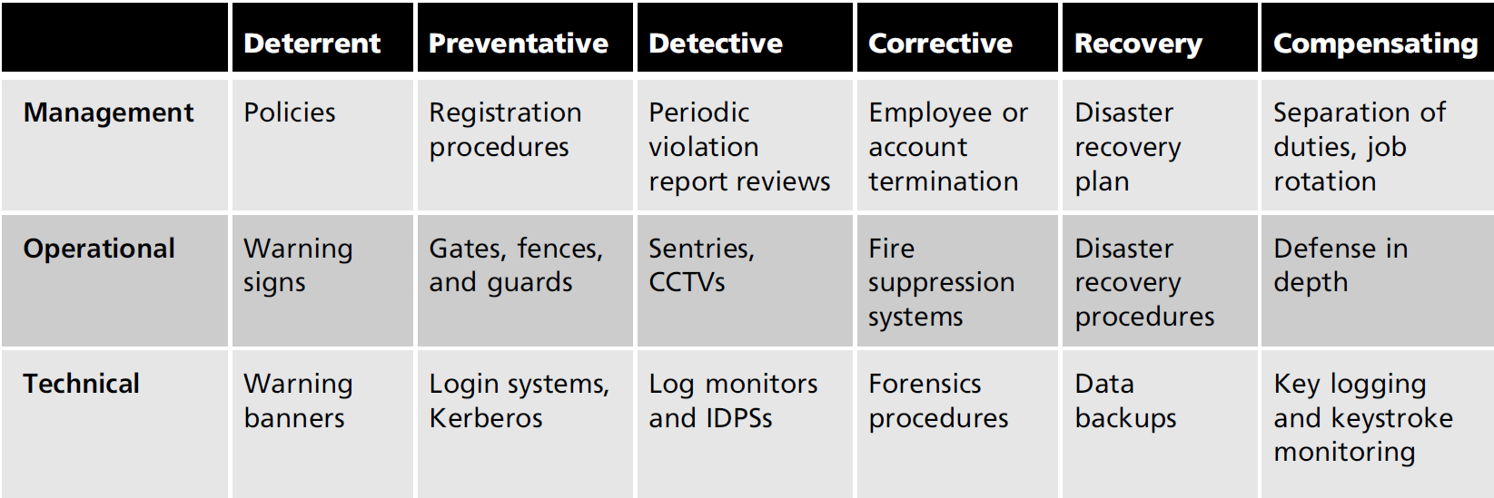
Categories of Access Control (cont’d.)
Table 6-1 Examples of controls by operational level and inherent characteristics
Source: Official (ISC)2 Guide to the CISSP CBK

Slide 11
Categories of Access Control (cont’d.)
The third approach describes the degree of authority under which the controls are applied:
Mandatory Access Controls (MACs)
Nondiscretionary Controls
Discretionary Access Controls (DACs)

Slide 12
Categories of Access Control (cont’d.)
Mandatory Access Controls (MACs)
Structured and coordinated within a data classification scheme that rates each collection of information as well as each user
These ratings are often referred to as sensitivity levels
When MACs are implemented, users and data owners have limited control over access to information resources

Slide 13
Categories of Access Control (cont’d.)
Data classification model
The U.S. military classification scheme relies on a more complex five-level classification scheme as defined in Executive Order 12958:
Unclassified data - Generally free for distribution to the public
Sensitive but unclassified (SBU) data - For Official Use Only
Confidential data - cause damage to the national security
Secret data - cause serious damage to the national security
Top secret data - cause exceptionally grave damage to the national security

Slide 14
Categories of Access Control (cont’d.)
Data classification model (con’t)
Data owners must classify the information assets for which they are responsible and review the classifications periodically
Example of classification types:
Public—For general public dissemination,
For official use only—Not for public release but not particularly sensitive
Sensitive—Important information
Classified—Essential and confidential information

Slide 15
Categories of Access Control (cont’d.)
Personnel Security clearance structure
Each user of an information asset is assigned an authorization level
Indicates the level of information classification they may access
Most organizations have developed roles and corresponding security clearances
Individuals are assigned into groups that correlate with the classifications of the of information assets they need for their work

Slide 16
Categories of Access Control (cont’d.)
Security clearance structure (cont’d.)
In the need-to-know principle, regardless of one’s security clearance, an individual is not allowed to view data simply because it falls within that individual’s level of clearance
Must have a business-related need to know
Hence ensures the confidentiality of information

Slide 17
Categories of Access Control
Managing an information asset
Considering its storage, distribution, portability, and destruction
An information asset that has a classification designation other than unclassified or public must be clearly marked as such
Must be available only to authorized individuals
To maintain the confidentiality of classified documents, managers can implement a clean desk policy
When copies of classified information are no longer valuable or too many copies exist, care should be taken to destroy them properly to discourage dumpster diving

Slide 18
Categories of Access Control (cont’d.)
Nondiscretionary controls
Determined by a central authority in the organization
Can be role-based or task-based
Role-based controls (RBAC) are tied to a particular user’s role in an organization
Task-based controls are tied to a particular assignment or responsibility

Slide 19
Categories of Access Control (cont’d.)
Discretionary Access Controls (DACs)
Implemented at the option of the data user
Users can allow general, unrestricted access, or they can allow specific individuals or sets of individuals to access the resources
Most personal computer operating systems are designed based on the DAC model
One discretionary model is rule-based access controls where access is granted based on a set of rules specified by the central authority

Slide 20
The ISO 27000 Series
Information Technology – Code of Practice for Information Security Management
One of the most widely referenced and discussed security models
Originally published as British Standard 7799 and then later as ISO/IEC 17799
Since been renamed ISO/IEC 27002
Establishes guidelines for initiating, implementing, maintaining, and improving information security management
Notes:
www.praxiom.com/iso-17799-intro.htm

Slide 21
The ISO 27000 Series (cont’d.)
ISO/IEC 27002 has 133 possible controls
Not all of which must be used
Need to identify which are relevant
Each section includes four categories of information:
One or more objectives
Controls relevant to the achievement of the objectives
Implementation guidance
Other information

Slide 22
The ISO 27000 Series (cont’d.)
Many countries did not originally adopted the model
Including the US, Germany, and Japan
Claims of fundamental flaws
Global InfoSec community has not defined any justification for the code of practice identified
Model lacks the necessary measurement precision of a technical standard
No reason to believe the model is more useful than any other approach
Not as complete as other frameworks
Perceived as being hurriedly prepared, given the tremendous impact that its adoption could have on industry information security controls

Slide 23
The ISO 27000 Series (cont’d.)
Security Consensus Operational Readiness Evaluation Audit Checklist (how close with ISO 27002)
Security policy
Organization of information security
Asset management
Human resources security
Physical and environmental security
Communications and operations management
Access control
Information systems acquisition, development and maintenance
Information security incident management
Business continuity management
Compliance

Slide 24
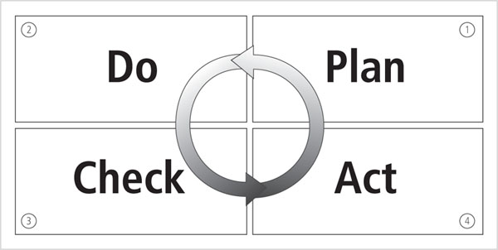
The ISO 27000 Series (cont’d.)
Figure 6-3 ISO/IEC 27001 Plan-Do-Check-Act

Slide 25
The ISO 27000 Series (cont’d.)
ISO/IEC 27001:2005 -The InfoSec Management System - Plan
Define the scope of the ISMS
Define an ISMS policy
Define the approach to risk assessment
Identify the risks
Assess the risks
Identify and evaluate options for the treatment of risk
Select control objectives and controls
Prepare a statement of applicability (SOA)

Slide 26
The ISO 27000 Series (cont’d.)
ISO/IEC 27001:2005 -The InfoSec Management System - Do
Formulate a risk treatment plan
Implement the risk treatment plan
Implement controls
Implement training and awareness programs
Manage operations
Manage resources
Implement procedures to detect and respond to security incidents

Slide 27
The ISO 27000 Series (cont’d.)
ISO/IEC 27001:2005 -The InfoSec Management System - Check
Execute monitoring procedures
Undertake regular reviews of ISMS effectiveness
Review the level of residual and acceptable risk
Conduct internal ISMS audits
Undertake regular management review of the ISMS
Record actions and events that impact an ISMS

Slide 28
The ISO 27000 Series (cont’d.)
ISO/IEC 27001:2005 -The InfoSec Management System - Act
Implement identified improvements
Take corrective or preventive action
Apply lessons learned
Communicate results to interested parties
Ensure improvements achieve objectives

Slide 29
NIST Security Models
Notable advantages of NIST documents
Publicly available at no charge
Have been available for some time
Have been broadly reviewed by government and industry professionals
Examples
SP 800-12, Computer Security Handbook
SP 800-14, Generally Accepted Security Principles & Practices
SP 800-18, Rev. 1, Guide for Developing Security Plans for Federal Information Systems
SP 800-30, Risk Management for Information Technology Systems

Slide 30
NIST Security Models (cont’d.)
NIST SP 800-12: Computer Security Handbook
Excellent reference and guide for the routine management of information security
Little guidance provided on design and implementation of new security systems
Use as supplement to gain a deeper understanding of background and terminology

Slide 31
NIST Security Models (cont’d.)
NIST SP 800-12: Computer Security Handbook (cont’d.)
Lays out the NIST philosophy on security management by identifying 17 controls organized into three categories
Management controls: addresses security topics that can be characterized as managerial
Operational controls: addresses security controls that focus on controls implemented and executed by people (as opposed to systems)
Technical controls: focuses on security controls that the computer system executes

Slide 32
NIST Security Models (cont’d.)
Management controls
Risk management
Review of security controls
Life cycle maintenance
Authorization of processing (certification and accreditation)
System security plan

Slide 33
NIST Security Models (cont’d.)
Operational controls
Personnel security
Physical security
Production, input/output controls
Contingency planning
Hardware and systems software
Data integrity
Documentation
Security awareness, training, and education
Incident response capability

Slide 34
NIST Security Models (cont’d.)
Technical controls
Identification and authentication
Logical access controls
Audit trails

Slide 35
NIST Security Models (cont’d.)
NIST Special Publication 800-14: Generally Accepted Principles and Practices for Securing Information Technology Systems
Describes best practices useful in the development of a security blueprint
Describes principles that should be integrated into information security processes
Documents 8 points and 33 principles

Slide 36
NIST Security Models (cont’d.)
Key points
Security supports organization’s mission
Security is integral to sound management
Security should be cost-effective
Systems owners have security responsibilities outside their own organizations
Security responsibilities and accountability should be explicit
Security requires a comprehensive and integrated approach
Security should be periodically reassessed
Security is constrained by societal factors

Slide 37
NIST Security Models (cont’d.)
Principles of NIST SP 800-14
1. Establish a sound security policy as the foundation for design
2. Treat security as an integral part of the overall system design
3. Clearly delineate the physical and logical security boundaries governed by associated security policies
4. Reduce risk to an acceptable level
5. Assume that external systems are insecure

Slide 38
NIST Security Models (cont’d.)
Principles of NIST SP 800-14 (cont’d.)
6. Identify potential trade-offs between reducing risk and increased costs and decrease in other aspects of operational effectiveness
7. Implement layered security (ensure no single point of vulnerability)
8. Implement tailored system security measures to meet organizational security goals
9. Strive for simplicity

Slide 39
NIST Security Models (cont’d.)
Principles of NIST SP 800-14 (cont’d.)
10. Design and operate an IT system to limit vulnerability and to be resilient in response
11. Minimize the system elements to be trusted
12. Implement security through a combination of measures distributed physically and logically
13. Provide assurance that the system is, and continues to be, resilient in the face of expected threats
14. Limit or contain vulnerabilities

Slide 40
NIST Security Models (cont’d.)
Principles of NIST SP 800-14 (cont’d.)
15. Formulate security measures to address multiple overlapping information domains
16. Isolate public access systems from mission critical resources
17. Use boundary mechanisms to separate computing systems and network infrastructures
18. Where possible, base security on open standards for portability and interoperability

Slide 41
NIST Security Models (cont’d.)
Principles of NIST SP 800-14 (cont’d.)
19. Use common language in developing security requirements
20. Design and implement audit mechanisms to detect unauthorized use and to support incident investigations
21. Design security to allow for regular adoption of new technology, including a secure and logical technology upgrade process

Slide 42
NIST Security Models (cont’d.)
Principles of NIST SP 800-14 (cont’d.)
22. Authenticate users and processes to ensure appropriate access control decisions both within and across domains
23. Use unique identities to ensure accountability
24. Implement least privilege
25. Do not implement unnecessary security mechanisms

Slide 43
NIST Security Models (cont’d.)
Principles of NIST SP 800-14 (cont’d.)
26. Protect information while being processed, in transit, and in storage
27. Strive for operational ease of use
28. Develop and exercise contingency or disaster recovery procedures to ensure appropriate availability
29. Consider custom products to achieve adequate security

Slide 44
NIST Security Models (cont’d.)
Principles of NIST SP 800-14 (cont’d.)
30. Ensure proper security in the shutdown or disposal of a system
31. Protect against all likely classes of attacks
32. Identify and prevent common errors and vulnerabilities
33. Ensure that developers are trained in how to develop secure software

Slide 45
NIST Security Models (cont’d.)
NIST Special Publication 800-18, Rev. 1: A Guide for Developing Security Plans for Federal Information Systems
Provides detailed methods for assessing, designing, and implementing controls and plans for various sized applications
Serves as a guide for the activities described in this chapter, and for the overall information security planning process
Includes templates for major application security plans

Slide 46
NIST Security Models (cont’d.)
NIST Special Publication 800-30: Risk Management Guide for Information Technology Systems
Provides a foundation for the development of an effective risk management program
Contains the definitions and the practical guidance necessary for assessing and mitigating risks identified within IT systems
Strives to enable organizations to better manage IT-related risks

Slide 47
NIST Security Models (cont’d.)
Control Objectives for Information and Related Technology (COBIT)
Provides advice about the implementation of sound controls and control objectives for InfoSec
Created by the Information Systems Audit and Control Association (ISACA) and the IT Governance Institute (ITGI) in 1992

Slide 48
NIST Security Models (cont’d.)
COBIT presents 34 high-level objectives that cover 215 control objectives
Objectives categorized into four domains:
Plan and organize
Acquire and implement
Deliver and support
Monitor and evaluate

Slide 49
NIST Security Models (cont’d.)
Plan and organize
Makes recommendations for achieving organizational goals and objectives through the use of IT
10 controlling objectives (PO1 – PO10)
Acquire and implement
Focuses on specification of requirements
Acquisition of needed components
Component integration
Examines ongoing maintenance and change requirements
7 controlling objectives (AI1 – AI7)

Slide 50
NIST Security Models (cont’d.)
Delivery and support
Focuses on the functionality of the system and its use to the end user
Examines systems applications: including input, processing, and output components
Examines processes for efficiency and effective of operations
13 high-level controlling objectives (DS1 – DS13)

Slide 51
NIST Security Models (cont’d.)
Monitor and evaluate
Seeks to examine the alignment between IT systems usage and organizational strategy
Identifies the regulatory requirements for which controls are needed
Monitors the effectiveness and efficiency of IT systems against the organizational control processes in the delivery and support domain
4 high-level controlling objectives (ME1 – ME4)

Slide 52
Security Management Practices
Value Proposition
Organizations strive to deliver the most value with a given level of investment
Developing and using sound and repeatable information security management practices makes accomplishing this more likely
Executives and supervisory groups want assurance that organizations are working toward the value proposition and measuring the quality of management practices.
This lecture explores various methods of program comparison including benchmarking and compliance measurement.

Slide 53
Benchmarking
To generate a security blueprint
Organizations usually draw from established security models and practices
Another way is to look at the paths taken by organizations similar to the one for which you are developing the plan
Benchmarking
Following the existing practices of a similar organization, or industry-developed standards
Can help to determine which controls should be considered
Cannot determine how those controls should be implemented in your organization

Slide 54
Standards of Due Care/Due Diligence
Categories of benchmarks
Standards of due care/due diligence
Best practices
Best practices include a sub-category of practices, called the gold standard, that are generally regarded as “the best of the best”

Slide 55
Standards of Due Care/Due Diligence (cont’d.)
Standard of due care
When organizations adopt minimum levels of security for legal defense, they may need to show that they have done what any prudent organization would do in similar circumstances
Due diligence
Implementing controls at this minimum standard
Requires that an organization ensure that the implemented standards continue to provide the required level of protection
Failure to demonstrate due care or due diligence can expose an organization to legal liability
If it can be shown that the organization was negligent in its information protection methods

Slide 56
Recommended Security Practices
Best Practices
Security efforts that seek to provide a superior level of performance in the protection of information
Considered among the best in the industry
Balance the need for information access with the need for adequate protection
Demonstrate fiscal responsibility
Companies with best practices may not be the best in every area
csrc.nist.gov/groups/SMA/fasp/index.html

Slide 57
Selecting Recommended Practices
Choosing which recommended practices to implement can pose a challenge for some organizations
In industries that are regulated by governmental agencies, government guidelines are often requirements
For other organizations, government guidelines are excellent sources of information and can inform their selection of best practices
Notes:
Csrc.nist.gov/groups/SMA/fasp/index.html

Slide 58
Selecting Recommended Practices (cont’d.)
Considerations for selecting best practices
Does your organization resemble the identified target organization of the best practice?
Are you in a similar industry as the target?
Do you face similar challenges as the target?
Is your organizational structure similar to the target?
Are the resources you can expend similar to those called for by the best practice?
Are you in a similar threat environment as the one assumed by the best practice?

Slide 59
Limitations to Benchmarking and Recommended Practices
The biggest barrier to benchmarking
Organizations don’t talk to each other
A successful attack is viewed as an organizational failure, and is kept secret, insofar as possible
More and more security administrators are joining professional associations and societies like ISSA and sharing their stories and lessons learned
An alternative to this direct dialogue is the publication of lessons learned

Slide 60
Baselining
A value or profile of a performance metric against which changes in the performance metric can be usefully compared (e.g, number of attacks per week that an organization experiences)
Process of measuring against established standards
Baseline measurements of security activities and events are used to evaluate the organization’s future security performance
Can provide the foundation for internal benchmarking
Information gathered for an organization’s first risk assessment becomes the baseline for future comparisons

Slide 61
Support for Baselining and Recommended Practices
Self-assessment for recommended security practices: 12 questions into 3 categories: people, processes and technology, which loosely map to the managerial, operational and technical areas of NIST.
People:
Do you perform background checks on all employees with access to sensitive data, areas, or access points?
Would the average employee recognize a security issue?
Would they choose to report it?
Would they know how to report it to the right people?

Slide 62
Support for Baselining and Recommended Practices (cont’d.)
Self-assessment for recommended security practices (cont’d.)
Processes
Are enterprise security policies updated on at least an annual basis, employees educated on changes, and consistently enforced?
Does your enterprise follow a patch/update management and evaluation process to prioritize and mediate new security vulnerabilities?
Are the user accounts of former employees immediately removed on termination?
Are security group representatives involved in all stages of the project life cycle for new projects?

Slide 63
Support for Baselining and Recommended Practices (cont’d.)
Self-assessment for recommended security practices (cont’d.)
Technology
Is every possible route to the Internet protected by a properly configured firewall?
Is sensitive data on laptops and remote systems encrypted?
Do you regularly scan your systems and networks, using a vulnerability analysis tool, for security exposures?
Are malicious software scanning tools deployed on all workstations and servers?

Slide 64
Performance Measures in Information Security Management
Costs, benefits and performance of InfoSec
Are measurable, despite the claim of some CISOs that they are not
Measurement requires the design and ongoing use of an InfoSec performance management program based on effective performance metrics

Slide 65
InfoSec Performance Management
Information security performance management
The process of designing, implementing and managing the use of collected data elements called measures
To determine the effectiveness of the overall security program
Measures are data points or computed trends that indicate the effectiveness of security countermeasures or controls

Slide 66
InfoSec Performance Management (cont’d.)
Organizations use three types of measures
Those that determine the effectiveness of the execution of information security policy (ISSPs)
Those that determine the effectiveness and/or efficiency of the delivery of information security services
Those that assess the impact of an incident or other security event on the organization or its mission

Slide 67
InfoSec Performance Management (cont’d.)
NIST SP 800-55 R1, Performance Measures in Information Security suggests
Consider the following factors
Measures must yield quantifiable information (percentages, averages, and numbers)
Data that supports the measures needs to be readily obtainable
Only repeatable information security processes should be considered for measurement
Measures must be useful for tracking performance and directing resources

Slide 68
InfoSec Performance Management (cont’d.)
Critical factors for the success of an information security performance program
Strong upper level management support
Practical information security policies and procedures
Quantifiable performance measures
Results oriented measures analysis

Slide 69
InfoSec Metrics
InfoSec metrics
Applying statistical and quantitative approaches of mathematical analysis to the process of measuring the activities and outcomes of the InfoSec program
Metrics means detailed measurements
Measures refers to aggregate, higher-level results
The two terms are used interchangeably in some organizations

Slide 70
InfoSec Metrics (cont’d.)
Questions to answer before collecting, designing, and using measures
Why should these statistics be collected?
What specific statistics will be collected?
How will these statistics be collected?
When will these statistics be collected?
Who will collect these statistics?
Where (at what point in the function’s process) will these statistics be collected?

Slide 71
Building the Performance Measures Program
An information security measures program
Must be able to demonstrate value to the organization
Necessary even with strong management support
Capability Maturity Model Integrated (CMMI)
One of the most popular references that support the development of process improvement and performance measures
Developed by The Software Engineering Institute at Carnegie Mellon

Slide 72
Building the Performance Measures Program (cont’d.)
Another popular approach
NIST SP 800 - 55 R1: Performance Measurement for Information Security
Major activities
The identification and definition of the current information security program
Development and selection of specific measures to gauge the implementation, effectiveness, efficiency, and impact of the security controls

Slide 73
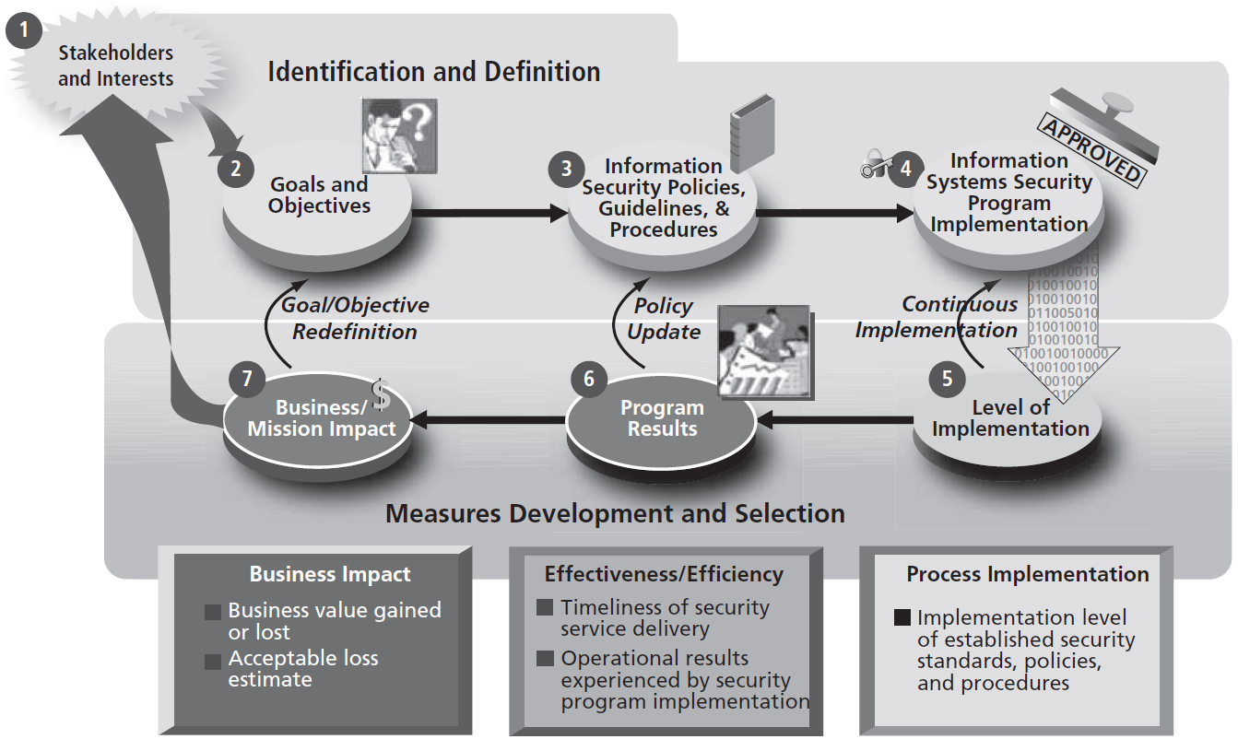
Building the Performance Measures Program (cont’d.)
Figure 7-1 Information security measures development process

Slide 74
Specifying InfoSec Measures
Assess and quantify what will be measured
One of the critical tasks
While InfoSec planning and organizing activities may only require time estimates
You must obtain more detailed measurements when assessing the effort spent to complete production tasks and the time spent completing project tasks

Slide 75
Collecting InfoSec Measures
Some thought must go into the processes used for data collection and record keeping
Once the question of what to measure is answered
The how, when, where, and who questions of metrics collection must be addressed
Designing the collection process requires consideration of the metric’s intent
Along with a thorough knowledge of how production services are delivered

Slide 76
Collecting InfoSec Measures (cont’d.)
Determine whether the measures used will be macro-focus or micro-focus
Macro-focus measures examine the performance of the overall security program
Micro-focus measures examine the performance of an individual controller or group of controls within the information security program
Or use both macro- and micro-focus measures in a limited assessment

Slide 77
Collecting InfoSec Measures (cont’d.)
Organizations manage what they measure
It is important to prioritize individual metrics in the same manner as the performance they measure
Use a simple low-, medium-, or high-priority ranking system
Or a weighted scale approach
Involves assigning values to each measure based on its importance in the overall information security program, and on the overall risk mitigation goals and the criticality of the systems

Slide 78
Collecting InfoSec Measures (cont’d.)
Performance targets
Make it possible to define success in the security program
Many measures have a 100% target goal
Other types of performance measures
Those that determine relative effectiveness, efficiency, or impact of information security on the organization’s goals
Are more subjective and require solid native and subjective reasoning

Slide 79
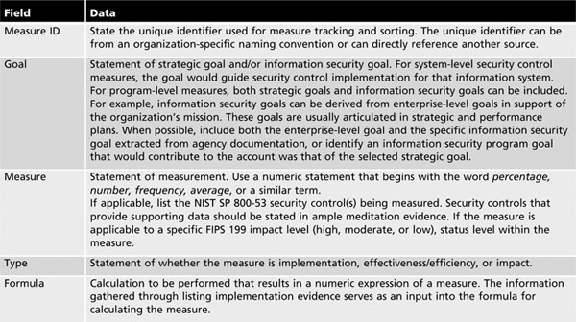
Collecting InfoSec Measures (cont’d.)

Slide 80
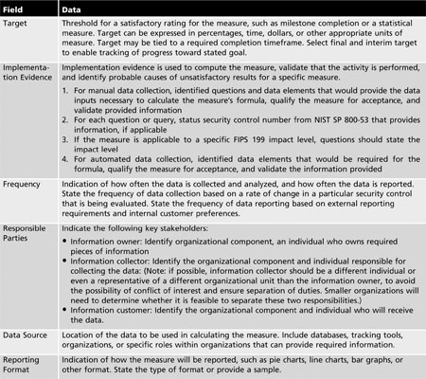
Table 7-3b Measures template and instructions

Slide 81
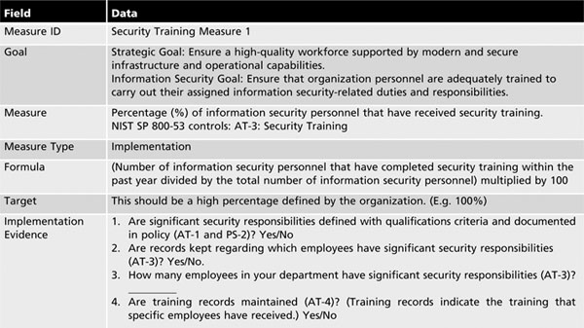
Collecting InfoSec Measures (cont’d.)

Slide 82
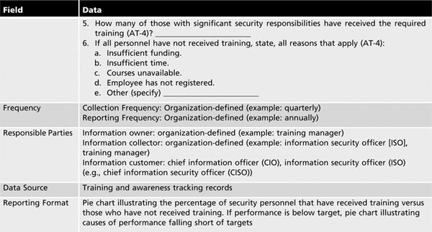
Collecting InfoSec Measures (cont’d.)

Slide 83
Collecting InfoSec Measures (cont’d.)
Candidate Measures
Percentage of the organization's information systems budget devoted to information security
Percentage of high vulnerabilities mitigated within organizationally defined time periods after discovery
Percentage space of remote access points used to gain unauthorized access
Percentage of information systems personnel that have received security training
Average frequency of audit records review and analysis for inappropriate activity
Percentage of new systems that have completed certification and accreditation (C&A) prior to their implementation
Percentage approved and implemented configuration changes identified in the latest automated baseline configuration

Slide 84
Collecting InfoSec Measures (cont’d.)
Candidate Measures (cont’d.)
Percentage of information systems that have conducted annual contingency plan testing
Percentage of users with access to shared accounts
Percentage of incidents reported within required time frame per applicable incident category
Percentage of system components that undergo maintenance in accordance with formal maintenance schedules
Percentage of media that passes sanitization procedures testing
Percentage of physical security incidents allowing unauthorized entry into facilities containing information assets
Percentage of employees who are authorized access to information systems only after they sign an acknowledgment that they have read and understood the appropriate policies

Slide 85
Collecting InfoSec Measures (cont’d.)
Candidate Measures (cont’d.)
Percentage of individuals screened before being granted access to organizational information and information systems
Percentage of vulnerabilities remediated within organization-specified time frames
Percentage of system and service acquisition contracts that include security requirements and/or specifications
Percentage of mobile computers and devices that perform all cryptographic operations using organizationally specified cryptographic modules operating in approved modes of operations
Percentage of operating system vulnerabilities for which patches have been applied or that have been otherwise mitigated

Slide 86
InfoSec Performance Measurement Implementation
Information security performance measures must be implemented and integrated into ongoing information security management operations
It is insufficient to simply collect these measures once
Performance measurement is an ongoing, continuous improvement operation

Slide 87
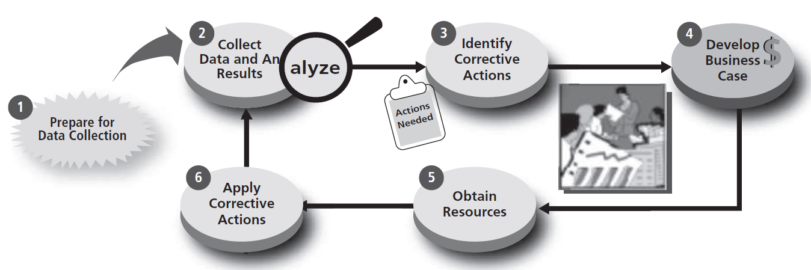
Collecting InfoSec Measures (cont’d.)
Figure 7-2 Information security measurement program implementation process

Slide 88
Reporting InfoSec Performance Measures
Listing the measurements collected does not adequately convey their meaning
Decisions must be made about how to present correlated metrics
Consider to whom the results of the performance measures program should be disseminated, and how they should be delivered

